Slide 1

Final Project : Classifying Email as Spam or Non-Spam

Slide 2

Problem Statement:
How to use data analysis and machine learning to effectively analyze email characteristics for efficient spam detection ?

Slide 3
Context: Spam Detection
Supervised Algorithm of Classification Type
Our target variable "spam" can only take 2 values, for example, 0 or 1.
If df["spam"] = 0, then the email is not spam.
If df["spam"] = 1, then the email is spam.
- We have 2 classes, making it a binary classification.

Slide 4
Table of contents 1. Data pre-processing 2.Data visualization 3.Modeling 4.Comparative Analysis of Model Performance Metrics

Slide 5

1. Data pre-processing
Encoding, normalization, imputation…

Slide 6
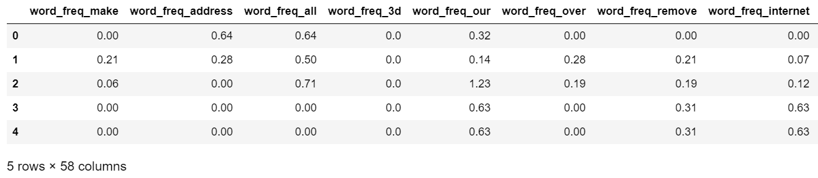
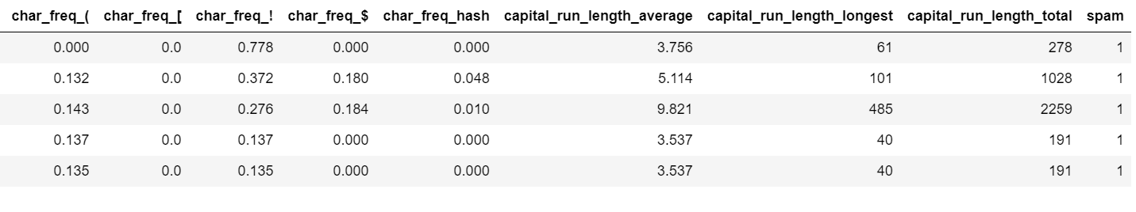
1.1 Load Dataset
...

Slide 7
Column descriptions
Word Frequency: word_freq_WORD
Character Frequency:
char_freq_CHAR
Sequence Length: capital_run_length_TYPE

Slide 8
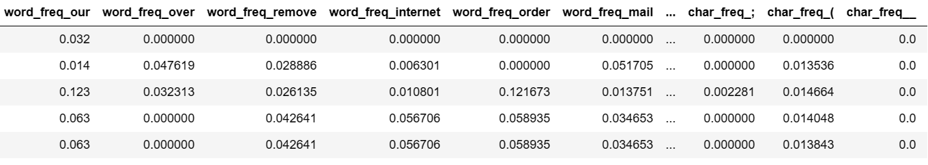
1.2 Data cleaning
We prepare the data for the application of some, algorithm like XGBoost, by cleaning and standardizing column names through the replacement of certain special characters with underscores.

Slide 9
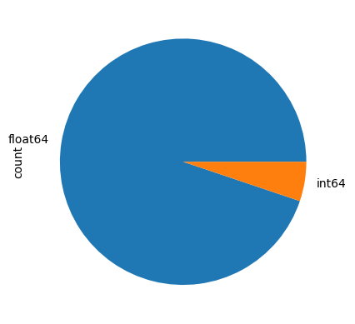
1.3 Data pre-processing: Data Encoding
Categorical Variable Encoding Not Required
All our variables are already numeric, so this step is not necessary

Slide 10
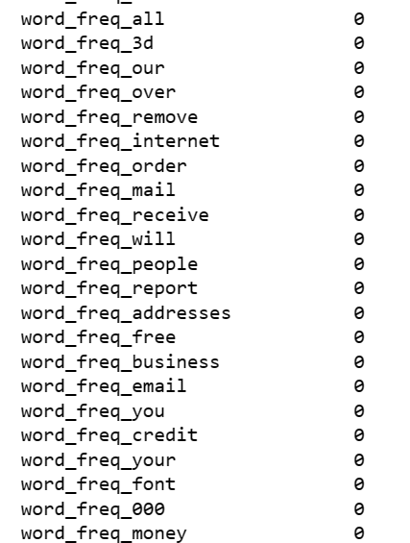
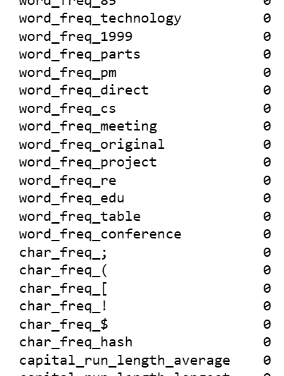
1.4 Data pre-processing: Imputation of missing data
We notice that our dataset does not contain any missing values. Therefore, the imputation step is not necessary.

Slide 11
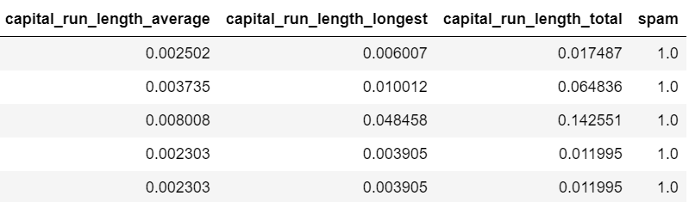
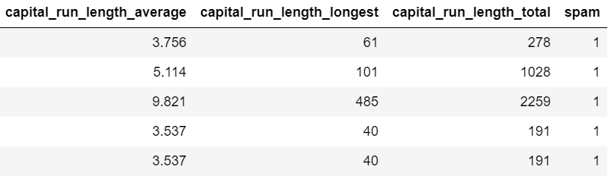
MinMaxScaler
1.5 Data pre-processing: Normalizing Data
The values are significantly higher in columns such as 'capital_run_length_longest,' 'capital_run_length_total,' and 'capital_run_length_average' compared to other columns.​
We need to perform data scaling for our all columns. ​
Datframe before scaling
Dataframe after scaling
=> Data normalizes to a specific range, typically between 0 and 1, preserving relative differences while maintaining the data distribution.

Slide 12

2. Data visualization
Showing the link between the variables and the target.

Slide 13
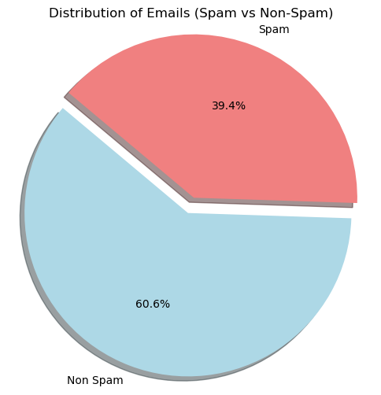
2.1 Class Distribution Plot
We notice that there are 39.4% of spam's email and 60.6% of non spam's email

Slide 14
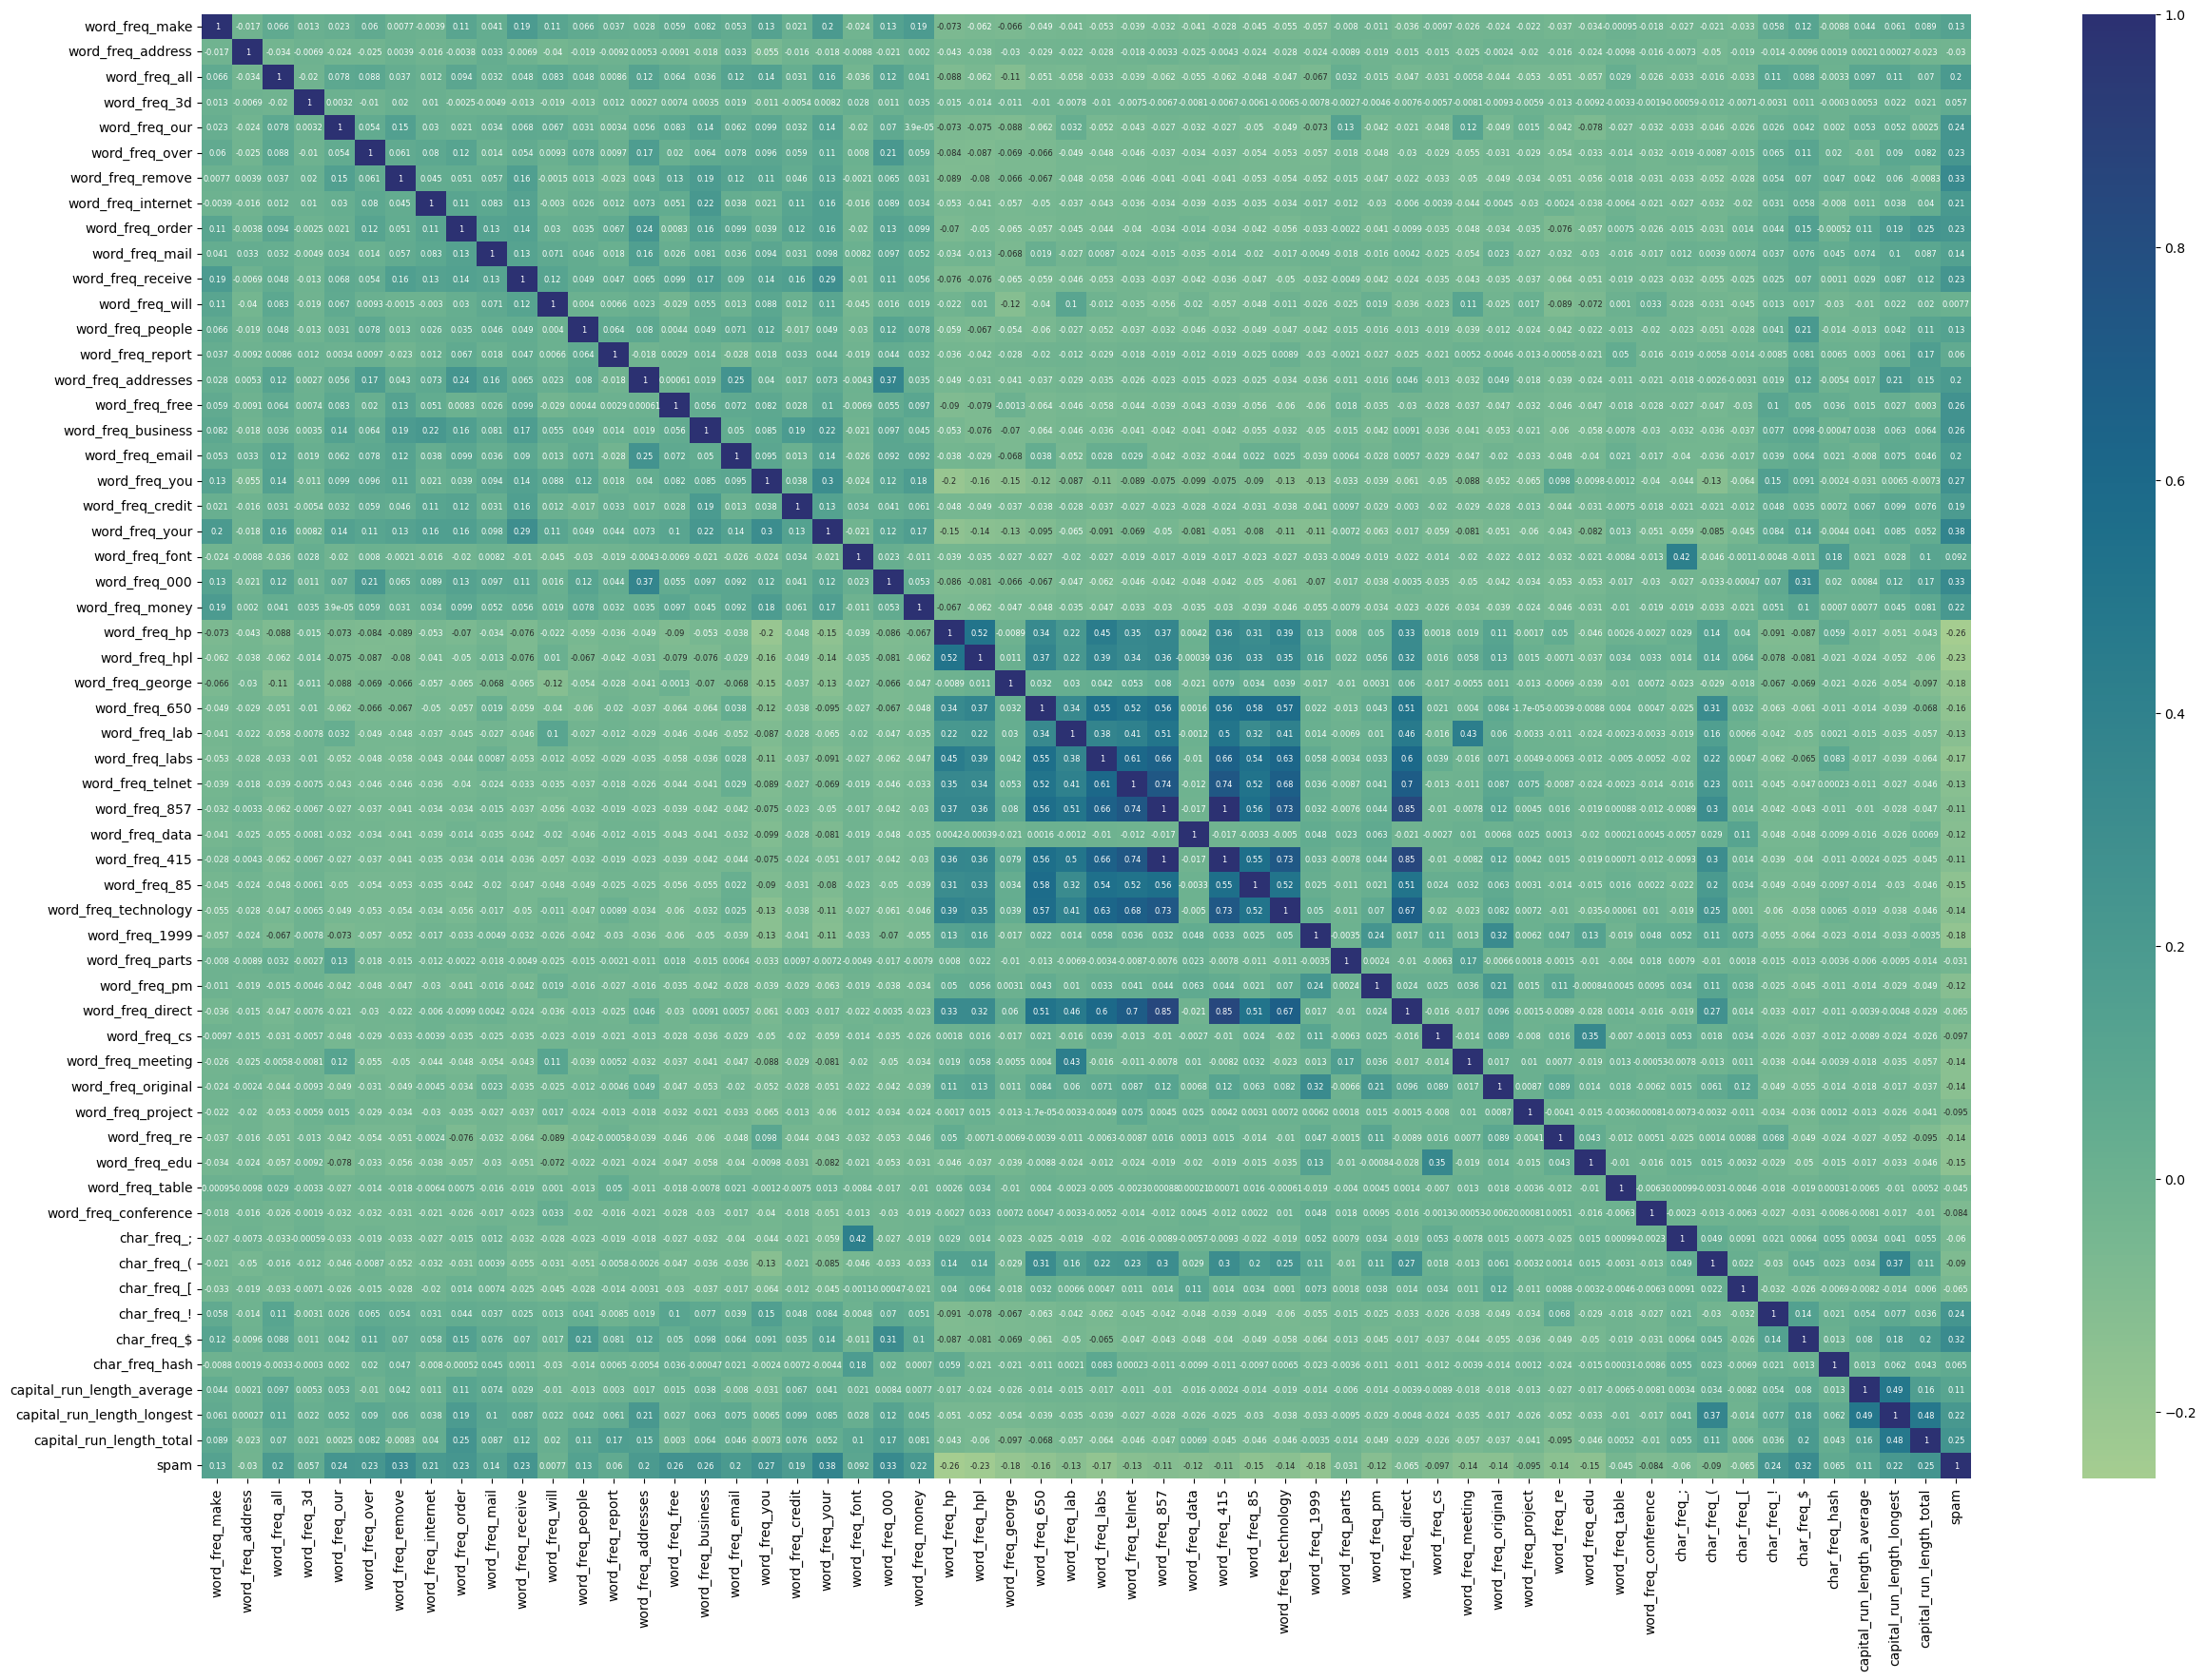
2.2 Correlation Matrix

Slide 15
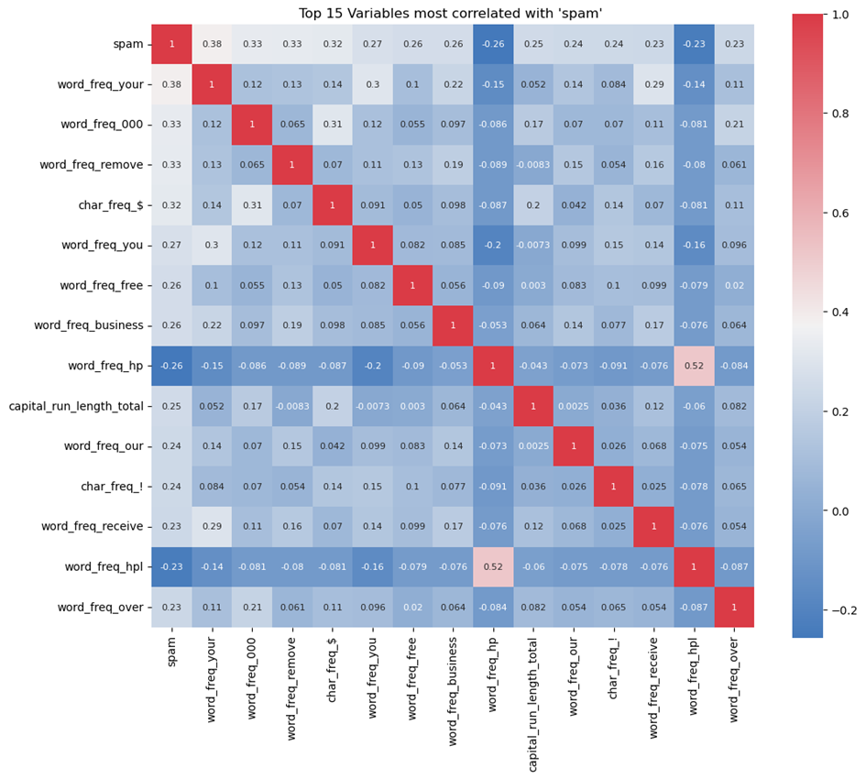
Correlation Analysis:
Top 15 Variables Most Correlated with 'spam'
Using the nlargest Method to Obtain the 15 Largest Absolute Correlation Values with the 'spam' Variable.
Several features show moderate to strong correlation with the 'spam' variable, such as 'word_freq_your' (0.38) and 'word_freq_000' (0.33).

Slide 16
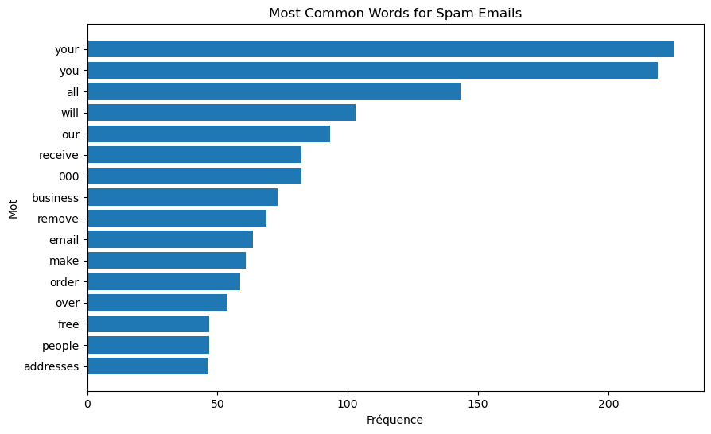
Most Common Words for Spam Emails
The terms "your," "you," and "free" appear most frequently, suggesting that they are commonly used in spam to grab the recipient's attention or offer enticing deals "business".

Slide 17

WordCloud – spam
Words like 'you,' 'your,' 'free,' and 'our' are highlighted, indicating that they are particularly common in spam.
This visualization is helpful for quickly identifying key terms that could be used to filter or flag unwanted emails.

Slide 18
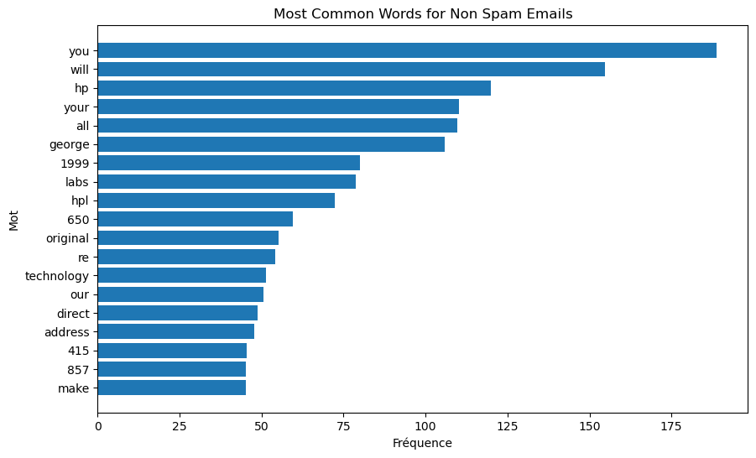
Most Common Words for Non Spam Emails
The terms like 'you,' 'will,' and 'your' are common, but there are also specific references such as 'hp' and 'george,' which could indicate proper nouns or technical terms related to a specific company or person.
This clearly shows that these emails are legitimate (non-spam).

Slide 19
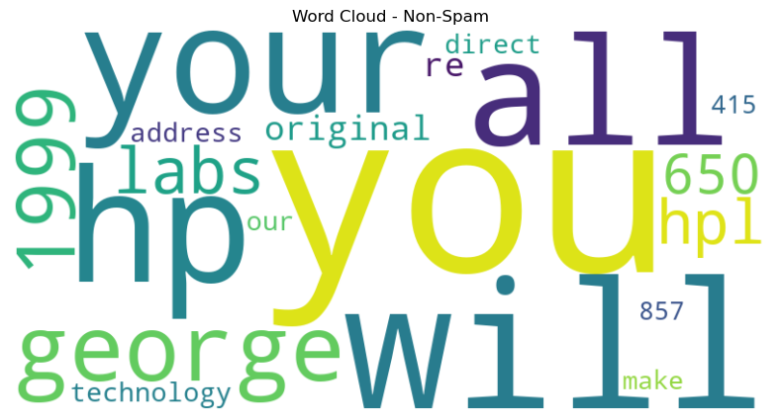
WordCloud – non spam
'hp,' 'you,' and 'will' are highly predominant, suggesting they are significant terms in regular non-spam communication.
Terms like '1999,' 'labs,' and numbers such as '650' and '857' could represent years, product names, or specific codes related to an organization or technical context.

Slide 20
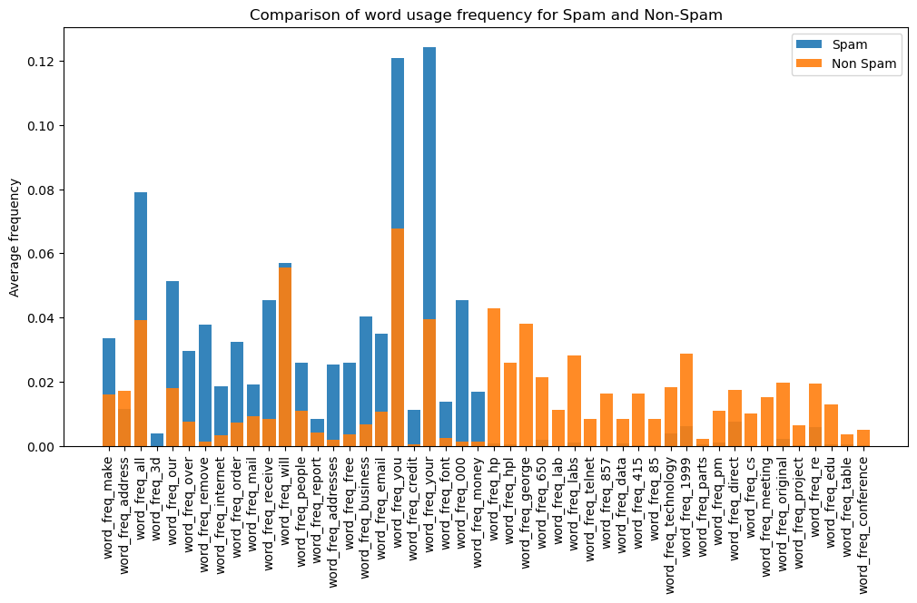
Average Frequency of Words According to Email Categories: Spam and Non-Spam​
Some words, such as 'money,' 'business,' 'credit,' 'remove,' and 'receive,' associated with urgency or financial appeal, appear to be much more frequent in spam emails than in non-spam emails.​​
Conversely, other words may be more common in non-spam emails, such as 'george,' 'hpl,' '847,' suggesting a more everyday language in regular communications.​​
​​

Slide 21
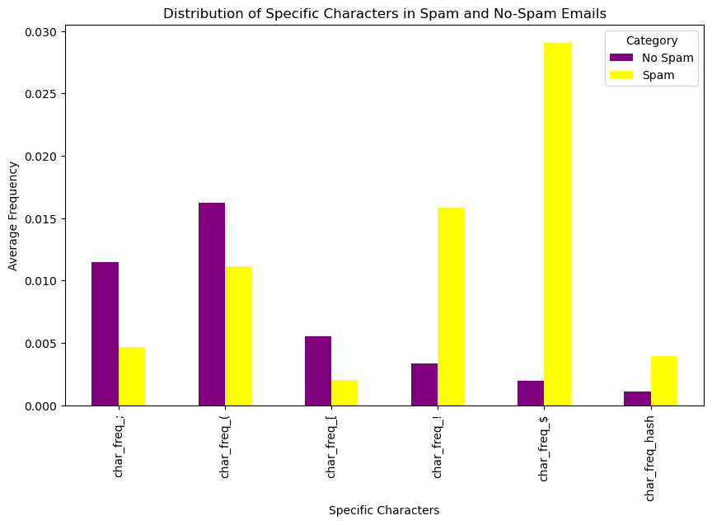
Distribution of Specific Characters in Spam and Non-Spam Emails
The visualization shows a significant difference in the frequency of specific characters, namely '!' and '$' , between spam and non-spam emails, with a much higher frequency in spam.

Slide 22
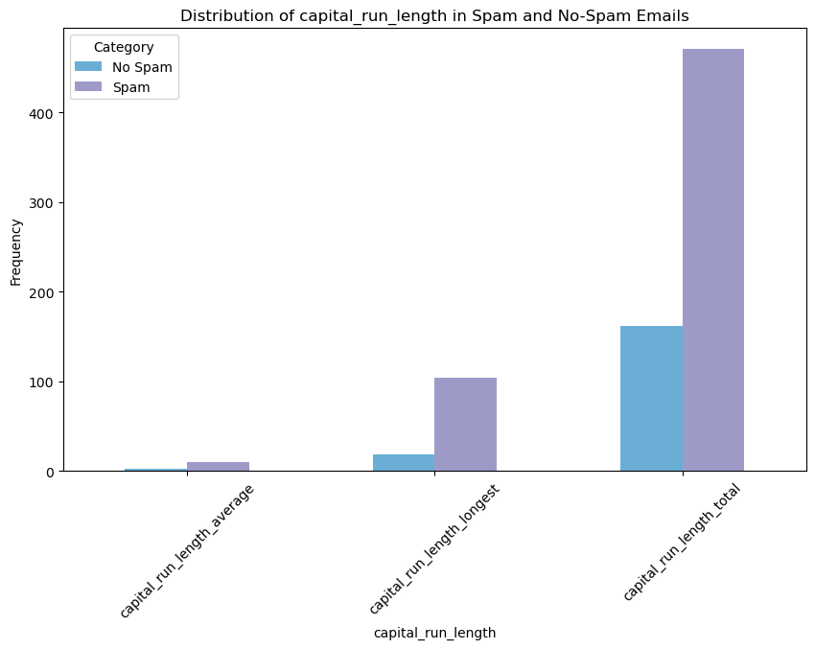
Analysis of capital sequences​
This bar plot indicates that the use of capital letters is more frequent and intensive in spams than in legitimate emails.

Slide 23
Decoding Email Content: Unveiling Spam and Non-Spam Traits
Common Features of Spam Emails :
- Specific Keywords: "business," "money," "free," and "you" are prevalent, indicating a focus on financial incentives and attractive offers.
- Special Characters: '!' and '$' are frequently used, suggesting the common use of urgency tactics and financial incentives.
Common Features of Non-Spam Emails:
- Specific Names and References: Inclusion of proper names like "George" and references to specific terms ("hp," "lab") suggest more legitimate and personalized communications.
- Specific Characters: Varied special characters like ';' and '[' are observed, pointing towards a more formal and professional language.
VS

Slide 24
3. Modeling
we follow these various steps :
import libraries
Split the Data into Training and Testing Sets
Grid Search for Hyperparameter Tuning
Create and Train the Best Model
Model Evaluation
ROC Curve and AUC Calculation
Confusion matrix
ROC curve
Display Metrics
Learning curve
For each of the following models :
- XGBClassifier (Xgboost Classification)
- Logistic Regression
- Random Forest Classifier
- Support Vector Classification

Slide 25
Evaluating Model Performance
Confusion Matrix ?
Confusion matrices are used to assess the performance of classification algorithms. They provide a detailed breakdown of the results obtained by a classification model. : True Positives, True Negatives, False Positives, False Negatives.
ROC curve ?
The ROC curve is a graphical tool to evaluate the performance of a binary classification model, plotting the true positive rate against the false positive rate at different classification thresholds.
Validation curve ?
Validation curves plot the model's performance (often precision) on training and validation sets against the size of the training set.

Slide 26
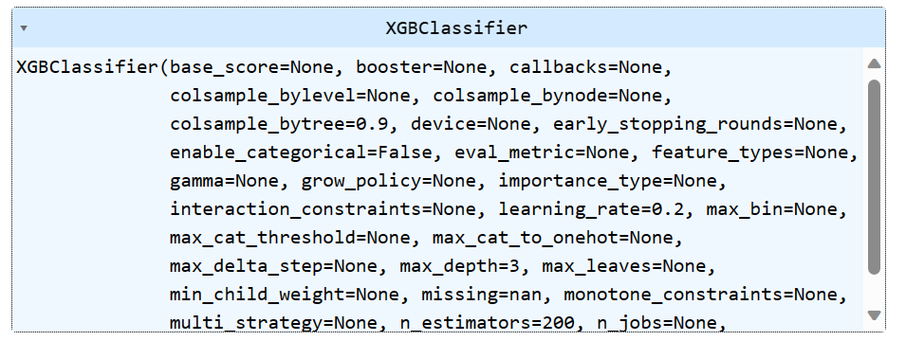
XGBoost
Grid Search for Hyperparameter Tuning
Create and Train the Best XGBoost Model
We evaluate the model

Slide 27
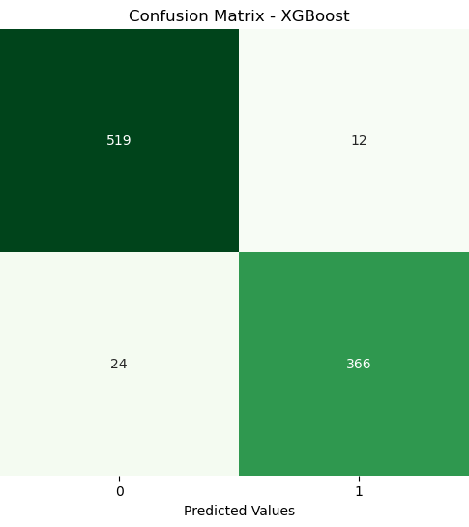
XGBoost - confusion matrix
True Positives: The model correctly predicted 366 cases as class 1 (e.g., spam)
True Negatives: The model correctly predicted 519 cases as class 0 (e.g., non-spam)
False Positives: The model incorrectly predicted 12 cases as class 1
False Negatives: The model incorrectly predicted 24 cases as class 0.

Slide 28
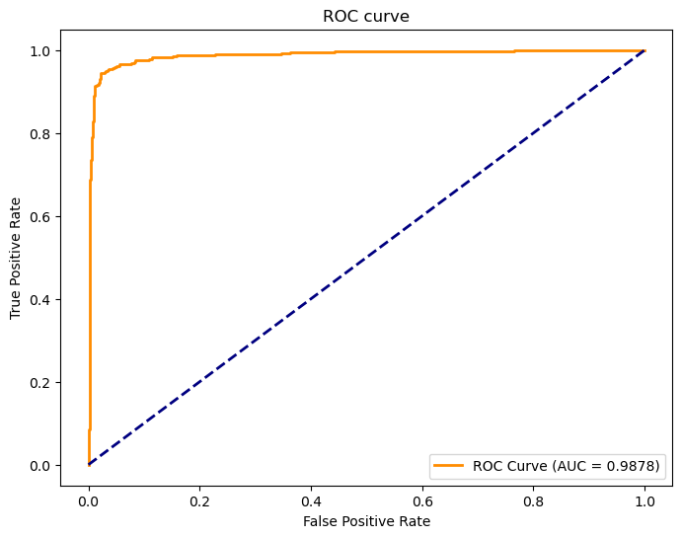
XGBoost – ROC curve
AUC close to 1: An AUC of 0.9878 is very close to the perfect value of 1, indicating excellent model performance.
Curve above the diagonal: The curve is well above the blue dashed line, representing a random classifier (AUC = 0.5). The farther the curve from this line, the better the performance.

Slide 29
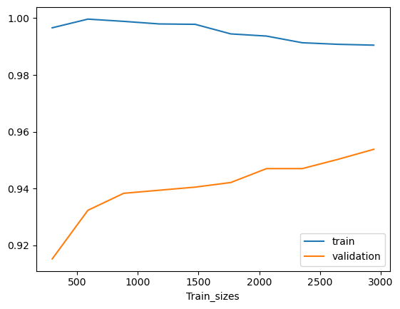
XGBoost – Learning curve
Training performance: Precision on the training set remains high and stable, indicating that the model is consistent across different training set sizes.
Validation performance: Precision on the validation set increases with the size of the training set, suggesting that the model learns better and generalizes better as more data is provided.
Gap between curves: The gap between training and validation precision decreases as more data is used, indicating a reduction in overfitting.
Convergence: The curves appear to converge, suggesting that increasing the training set size may not lead to a significant improvement in precision beyond a certain point.

Slide 30
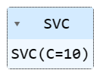
SVC
Grid Search for Hyperparameter Tuning
Create and Train the Best SVC Model
We evaluate the model

Slide 31
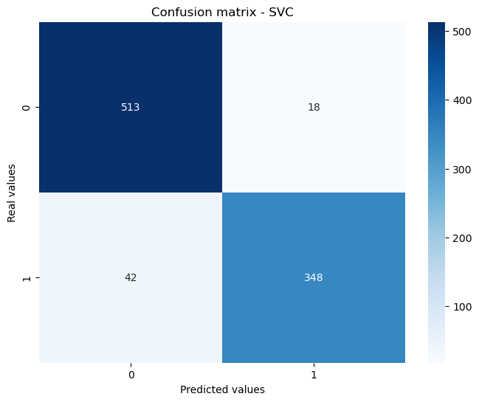
SVC – confusion matrix
True Positives: The model correctly predicted 513 instances as negative class (0)
True Negatives: The model correctly predicted 348 instances as positive class (1)
False Positives: The model incorrectly predicted 18 instances as positive class (1).
False Negatives: The model incorrectly predicted 42 instances as negative class (0).

Slide 32
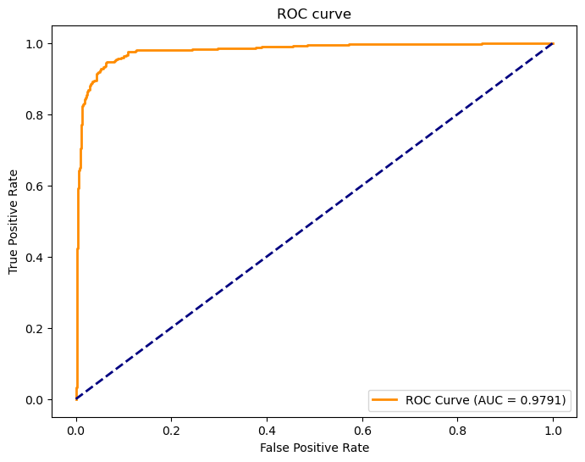
SVC – ROC curve
The AUC (Area Under Curve) is 0.9791, which is very high, indicating that the model has excellent discriminatory ability between the positive and negative classes.
The curve is significantly away from the line of no-discrimination (dotted line), which is a sign of good performance.

Slide 33
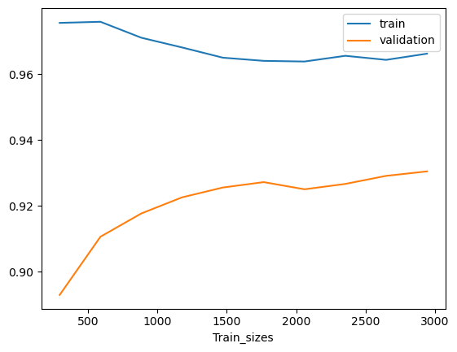
SVC- Learning curve
The accuracy on the training set (blue curve) remains relatively stable as the size of the training set increases.
The accuracy on the validation set (orange curve) increases with the size of the training set, suggesting improved generalization with more data.
The convergence of the curves indicates that increasing the size of the training set does not lead to significant overfitting.

Slide 34
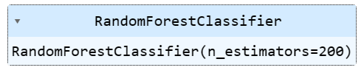
Random Forest Classifier
Grid Search for Hyperparameter Tuning
Create and Train the Best RandomForestClassifier Model
We evaluate the model :

Slide 35
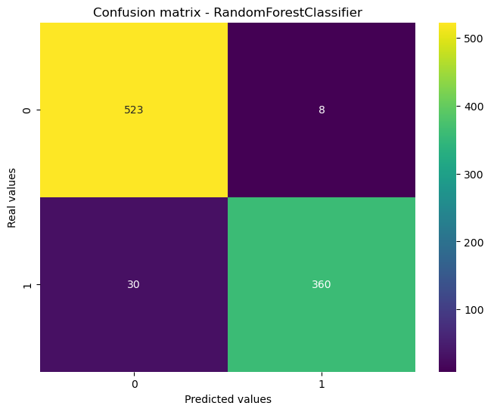
Random Forest Classifier– confusion matrix
True Negatives: The model correctly predicted 523 instances as negative class (0)
False Positives: The model incorrectly predicted 8 instances as positive class (1)
False Negatives: The model incorrectly predicted 30 instances as negative class (0)
True Positives: The model correctly predicted 360 instances as positive class (1)

Slide 36

Random Forest Classifier– ROC curve
The AUC (Area Under the Curve) is 0.9866, which is very high, indicating excellent class separation capability.
The curve significantly deviates from the diagonal line, demonstrating good model performance.

Slide 37
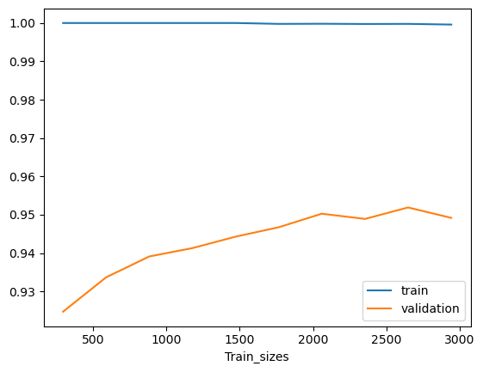
Random Forest Classifier– Learning curve
The training set accuracy (blue curve) is high and stable, suggesting that the model fits well to the training data. The validation set accuracy (orange curve) increases with the size of the training set, indicating better generalization with more data.
The curves appear to converge, indicating that adding more training data may not significantly improve performance on the validation set.

Slide 38
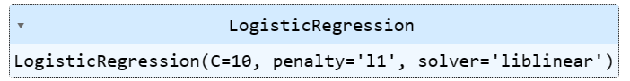
Logistic Regression
Grid Search for Hyperparameter Tuning
Create and Train the Best best LogisticRegression model
We evaluate the model :

Slide 39
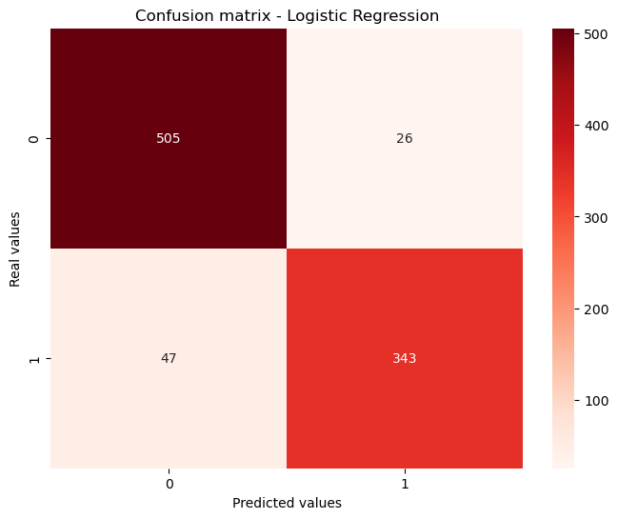
Logistic Regression– confusion matrix
True Negatives: The model correctly predicted 505 cases as negative class (0)
False Positives: The model incorrectly predicted 26 cases as positive class (1)
False Negatives: The model incorrectly predicted 47 cases as negative class (0)
True Positives: The model correctly predicted 343 cases as positive class (1)

Slide 40

Logistic Regression– ROC curve
The AUC (Area Under Curve) is 0.9702, which is very high, indicating a strong ability of the model to distinguish between positive and negative classes.
The curve deviates significantly from the diagonal line (representing a random model), which is indicative of good performance.

Slide 41
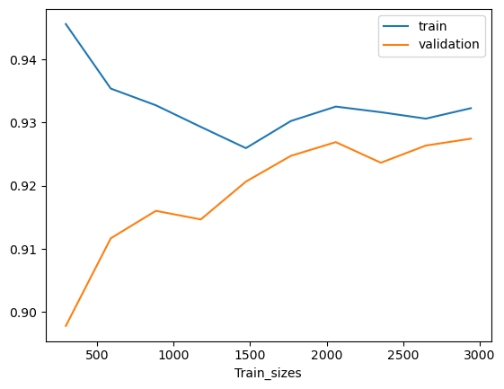
Logistic Regression– Learning curve
The accuracy on the training set slightly decreases as the size of the training set increases, which may indicate that the model is slightly overfitting on small datasets.
The accuracy on the validation set initially increases with the size of the training set but starts to stabilize, indicating that adding more data enhances the model's ability to generalize, up to a certain point.

Slide 42
4. Comparative Analysis of Model Performance Metrics
For each model, we will assess and compare the following metrics.
Metrics comparison:
- Accuracy
- AUC-ROC
We use the AUC-ROC as a metric because this metric is used for binary classification.
Our subject is based on this type of classification

Slide 43
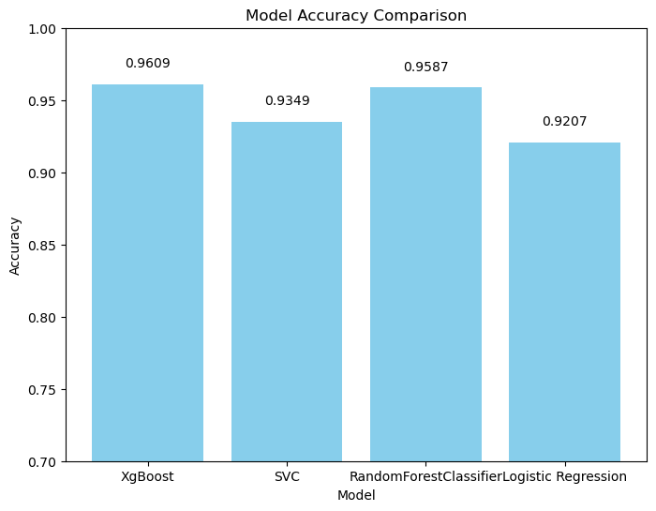
4.1 Accuracy
This chart suggests that XGBoost and RandomForestClassifier are the most performing models for this data, with an accuracy exceeding 95%.
The SVC also demonstrates good performance, albeit slightly lower, and logistic regression has the lowest accuracy, although still above 92%.

Slide 44
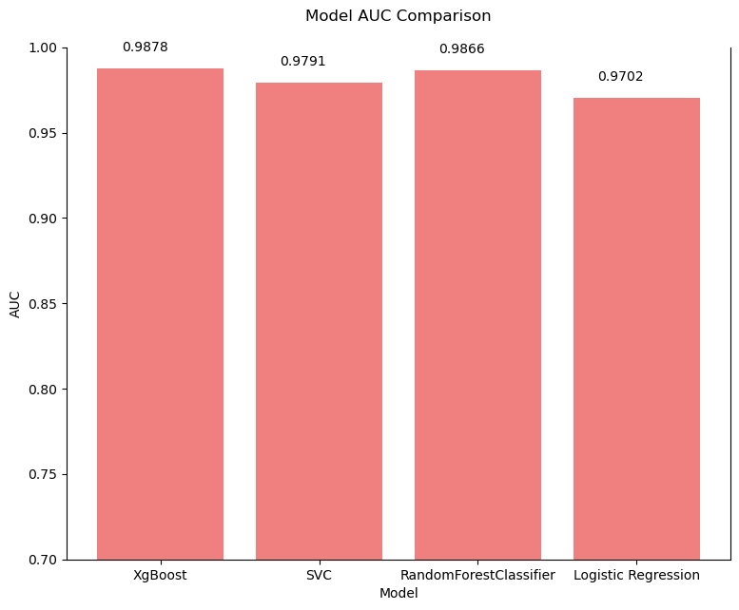
4.2 AUC
All models exhibit high AUC scores, indicating that they are all quite effective at correctly classifying positive and negative instances.
XGBoost and RandomForestClassifier slightly outperform the others.

Slide 45
Conclusion:
Model Evaluation :
XGBoost emerges as the most pertinent model, boasting the highest AUC and accuracy.
Its learning curve indicates strong performance and generalization to new data.
Other models, while performing well, don't surpass XGBoost in these metrics.

Slide 46


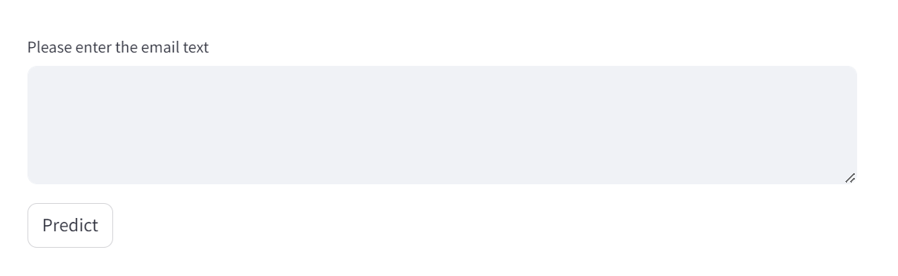

Slide 47


Let's play 😉

